Slide 1
Frederick County Board of Health
July 21, 2025
Call to Order (6pm) – Dr. Barbara Brookmyer, Health Officer for Frederick County
Public Comments (6:00p.m. – 6:15 p.m. p.m.) - Members of the public will be given three (3) minutes to provide comments - available to attendees in the room.
Approval of Minutes: 05/15/2025
Old Business:
  Liaisons
    Discussion of Recommended Appointments
    Confirmation of Recommended Appointments
  Environmental Health Cost of Service Adjustment
    Discussion
    Vote
Upcoming Meetings
October 22, 2025

Slide 2
Public Comment

Slide 3
Public Comment
The Frederick County Board of Health welcomes and encourages public comment.
Public comment is not intended to be a question-and-answer platform with the Board members. Generally, Board members will not respond to comments made.
Public comment is open to members of the public who are present in the room. Individual providing public comment have up to 3 minutes and will be asked to complete comments when the buzzer sounds. A total of 15 minutes is allocated for public comment on today’s agenda.
Members of the public wishing to share additional comments with the committee may do so by emailing boardofhealth@frederickcountymd.gov.

Slide 4
Approval of Minutes

Slide 5
Recommended Appointments of
Liaisons to the Board of Health

Slide 6
Liaison Positions - Qualifications
Purpose: Liaisons shall serve as a resource, provide information and data, and answer questions as needed or requested by the Board of Health.
The Board shall appoint the following 6 liaisons:
An epidemiologist
A nurse
A mental health professional
A veterinarian
A member from the Frederick Chamber of Commerce, and
One (1) person with a science related background

Slide 7
FY2025 Liaison Cohort
Liaison | Term Details
Chamber of Commerce member – Dr. Diana P. Castiblanco | Ended 6/30/2025
Mental Health Professional - Dr. Alison Bomba | Ended 6/30/2025
Epidemiologist – Dr. René F. Najera | 1 more year, ends 6/30/2026
Veterinarian – Dr. Michael Schaden | 1 more year, ends 6/30/2026
Nurse – Dr. Jennifer Cooper | 2 more years, ends 6/30/2027
Science Related Background – Dr. Scott Staley | 2 more years, ends 6/30/2027

Slide 8
Liaison Recruitment Process
Application opened in May for Chamber of Commerce member and Mental Health Professional, closed in June
Health Department reviewed applications and made recommendations
Board of Health meet with recommended candidates in July
Health Officer will provide background and onboarding information for new liaisons prior to October meeting

Slide 9
Liaison Positions – Appointment Terms
Liaisons shall be appointed and confirmed by a majority of the Board of Health
Liaisons shall have no voting privileges, and will not be counted in determining the presence of a quorum
Liaisons will serve without compensation.
With the exception of some of the initial appointments, the term of office of each of the members shall be for a period of three (3) years.

Slide 10
Liaison Positions – Appointment Terms, cont’d
Liaisons may be reappointed but may not serve more than 2 full consecutive 3-year terms.
Vacancies shall be filled on the same basis as the original appointments for unexpired terms and shall be filled with a person of the same or similar background of the liaisons being replaced.
Liaisons shall continue in office until their successors are appointed and qualified.

Slide 11
Recommended FY2026 Liaison Cohort
Liaison | Term Details
Chamber of Commerce member – Ms. Katie Silver | 3 years, ends 6/30/2028
Mental Health Professional – Dr. Sara Singh | 3 years, ends 6/30/2028
Epidemiologist – Dr. René F. Najera | 1 more year, ends 6/30/2026
Veterinarian – Dr. Michael Schaden | 1 more year, ends 6/30/2026
Nurse – Dr. Jennifer Cooper | 2 more years, ends 6/30/2027
Science Related Background – Dr. Scott Staley | 2 more years, ends 6/30/2027

Slide 12
Confirmation of
Liaisons to the Board of Health

Slide 13
Liaison Recruitment – Next Steps in the Process
Packet of all applications distributed to all members
All members review applications – closed session and narrow down to 1 applicant
All members vote on applications – open session vote on single applicant per category
Notes:
Do you want references?
Do you want to interview applicants?

Slide 14
Environmental Health
Cost of Service Adjustment

Slide 15
Environmental Health
Cost of Service Adjustment:
Discussion

Slide 16
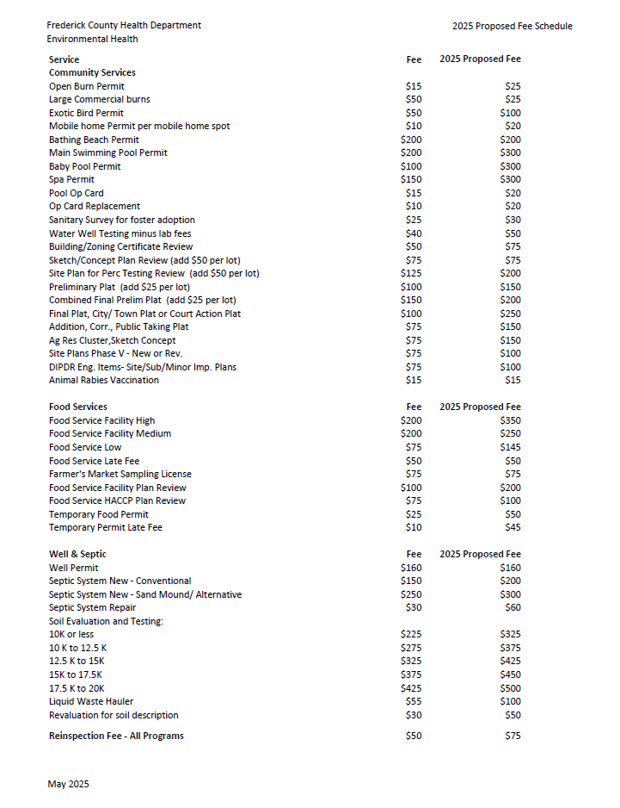
Highlights of Proposed
Cost of Service Adjustment
 | Current FC Fee | Proposed FC Fee | % Increase
Residential Burn Permit | $15 | $25 | 66%
Food Facility (high priority) | $200 | $350 | 75%
Swimming Pool Inspection | $200 | $300 | 50%
New Septic System | $150 | $200 | 20%
Expenses have increased overall 83%.
Based on inflation our fees should have increased 47%.
Handout provides list of current and proposed fees.

Slide 17
Community Services
Service | Current Fee | Proposed Fee
Open Burn Permit | $15 | $25
Large Commercial burns | $50 | $25
Exotic Bird Permit | $50 | $100
Mobile home Permit per mobile home spot | $10 | $20
Bathing Beach Permit | $200 | $200
Main Swimming Pool Permit | $200 | $300
Baby Pool Permit | $100 | $300
Spa Permit | $150 | $300
Pool Op Card | $15 | $20
Op Card Replacement | $10 | $20
Sanitary Survey for foster adoption | $25 | $30
Water Well Testing minus lab fees | $40 | $50

Slide 18
Community Services, continued
Service | Current Fee | Proposed Fee
Building/Zoning Certificate Review | $50 | $75
Sketch/Concept Plan Review (add $50 per lot) | $75 | $75
Site Plan for Perc Testing Review (add $50 per lot) | $125 | $200
Preliminary Plat (add $25 per lot) | $100 | $150
Combined Final Prelim Plat (add $25 per lot) | $150 | $200
Final Plat, City/ Town Plat or Court Action Plat | $100 | $250
Addition, Corr., Public Taking Plat | $75 | $150
Ag Res Cluster, Sketch Concept | $75 | $150
Site Plans Phase V - New or Rev. | $75 | $100
DIPDR Eng. Items- Site/Sub/Minor Imp. Plans | $75 | $100
Animal Rabies Vaccination | $15 | $15

Slide 19
Food Services
Service | Current Fee | Proposed Fee
Food Service Facility High | $200 | $350
Food Service Facility Medium | $200 | $250
Food Service Low | $75 | $145
Food Service Late Fee | $50 | $50
Farmer's Market Sampling License | $75 | $75
Food Service Facility Plan Review | $100 | $200
Food Service HACCP Plan Review | $75 | $100
Temporary Food Permit | $25 | $50
Temporary Permit Late Fee | $10 | $45

Slide 20
Well & Septic Services
Service | Current Fee | Proposed Fee
Well Permit | $160 | $160
Septic System New - Conventional | $150 | $200
Septic System New - Sand Mound/ Alternative | $250 | $300
Septic System Repair | $30 | $60
Soil Evaluation and Testing:
10K or less | $225 | $325
10 K to 12.5 K | $275 | $375
12.5 K to 15K | $325 | $425
15K to 17.5K | $375 | $450
17.5 K to 20K | $425 | $500
Liquid Waste Hauler | $55 | $100
Revaluation for soil description | $30 | $50

Slide 21
Environmental Health
Cost of Service Adjustment:
Vote

Slide 22
Frederick County Board of Health
July 21, 2025
Call to Order (6pm) – Dr. Barbara Brookmyer, Health Officer for Frederick County
Public Comments (6:00p.m. – 6:15 p.m. p.m.) - Members of the public will be given three (3) minutes to provide comments - available to attendees in the room.
Approval of Minutes: 05/15/2025
Old Business:
  Liaisons
    Discussion of Recommended Appointments
    Confirmation of Recommended Appointments
  Environmental Health Cost of Service Adjustment
    Discussion
    Vote
Upcoming Meetings
October 22, 2025

